Slide 1


Slide 2
Topic –Method of working of continuous miner in underground coal.

Slide 3
Continuous miner
Continuous miner is a mining machine that produces a constant flow of coal from the working face of the mine. The machine continuously extracts as it is loading coal with a cutting steel drum and conveyor system. The continuous miner has been available in some form since the late 1800s. The first machine to resemble a continuous miner was known as the English Channel Machine.

Slide 4
WHY continuous miner?
Speed
Efficiency
Constant flow of coal
No blasting

Slide 5
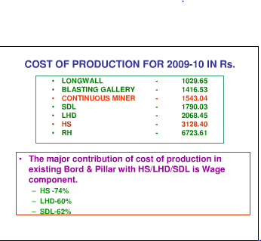
Cost of production/tonne(SCCL)

Slide 6
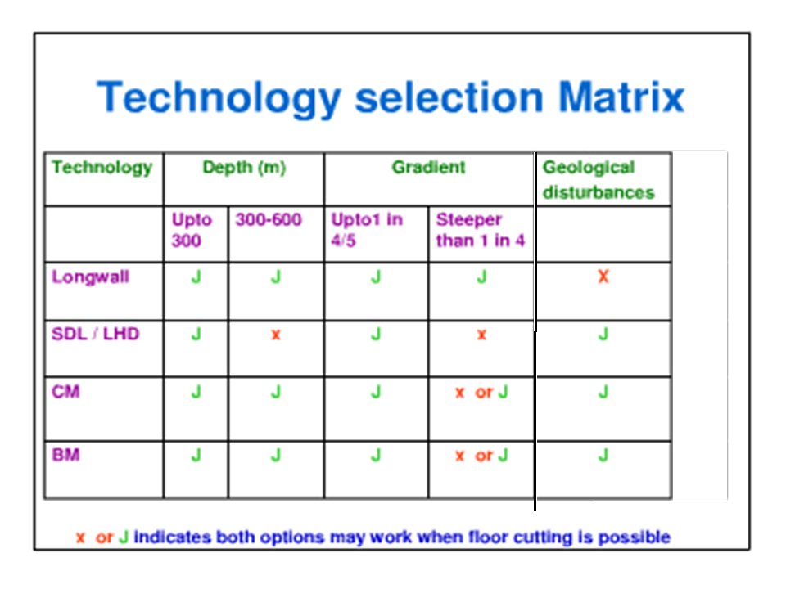

Slide 7
DIFFERENT TYPES
• Auger head continuous miner
• Borer-type continuous miner
• Drum head type continuous miner
• Oscillating head ripper miner
• Remote-controlled or robotic miner
o Ripper-type continuous miner

Slide 8
Continuous Miner’s parts
Though there are many variations in design, continuous miners mostly consist of five main elements:
✓A central body to carry all other components mounted on some type of drive
mechanism to provide mobility (most commonly caterpillar tracks).
A "cutting head" usually rotating drum(s) and/or chains with cutting picks attached.
✓A loading mechanism to pick up cut coal and deliver it into the central part of the machine.
✓A conveying system, usually a chain conveyor running in a steel trough from front to
rear of the miner.
✓A rear jib section capable of a degree of vertical and horizontal movement to enable
the coal to be delivered into a transport or loaded at a desired point.

Slide 9
How it works?
Continuous miners consist of a large rotating drum comprising steel and tungsten carbide teeth, a material with enough strength to scrape coal from the seam or face of the mine. Used in room and pillar mining operations, the mine is often series of rooms, usually 20 to 30 feet (6.1 to 9.1 m) in length. The continuous miner rotates the oscillating steel drum to cut a way designated sections of the coal bed. When the coal is extracted, a conveyor system is utilized to transport and load the coal from the seam.

Slide 10
The most commonly employed type of continuous miner is the milling head miner .
This type of miner has a rotating drum that rips the coal from the seam. The fallen coal is then collected by gathering arms and moved toward the back of the miner by an onboard chain conveyor. This conveyor runs up an adjustable boom that is used to load a shuttle car, which
carries the coal to the main belt. A typical system uses two shuttle cars traveling sequentially between the continuous miner and the loading point on to a belt conveyor.

Slide 11
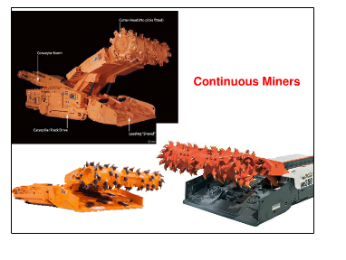

Slide 12
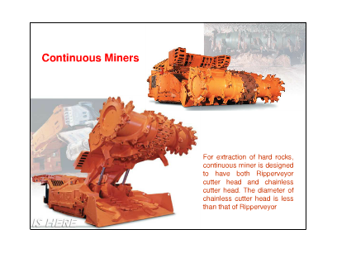
.3

Slide 13
Technical parameters
•Depth-can be used for greater depths (more than 300).
• Gradient-1 in 4.
• Floor Pressure or Ground Pressure-varies from 0.11 MPa (16 Psi) to 0.22 MPa (32 Psi).
• Cut out Distance –depends on geo mining condition . For CMRI RMR 48,the cut out dist.- 12 m, and for 62 it is 15 m.
• Number of Entries-generally 5 entries panels are preffered.
• Angle between entries and crosscuts –depends on machinery.

Slide 14
Operational parameters
• Floor Condition
• Watery condition
• Cables handling & Equipment Rerouting
• Damage of Cables & Tyres.
• Bolter & Miner Compatibility
• Fire problem
• Ventilation
• Roadway Maintenance
• Extraction of Developed Pillars

Slide 15
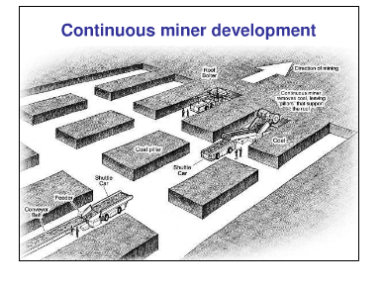

Slide 16
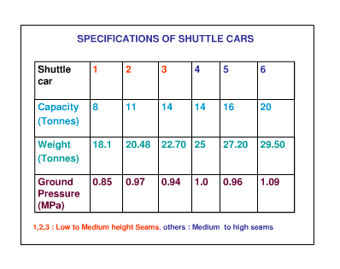

Slide 17
Common manufactures
• Bucyrus International
•
• Joy Mining Machinery
•
• Siemens
•
• Sandvik
•
• Eickhoff

Slide 18
Advantages
•Continuous Miner can extract the coal to full seam thickness of 4.5m to 5.0m in a single lift.
•Strata control problems can be minimized by avoiding blasting operations as the depth is increasing 350m and more.
• It gives higher production rates.
• Remote operation leads to safety.
• Risk of spontaneous heating can be reduced due to faster rate of extraction.
• Moderate Capital cost when compared to Longwall mining.

Slide 19
WORKING WITH CONTINUOUS MINER AT GDK-11 INCLINE / RAMAGUNDAM- A CASE STUDY(AT PANEL B1,B2 AND B3)
Content of study
Production
Problems
Performance
Cost analysis and
conclusion

Slide 20
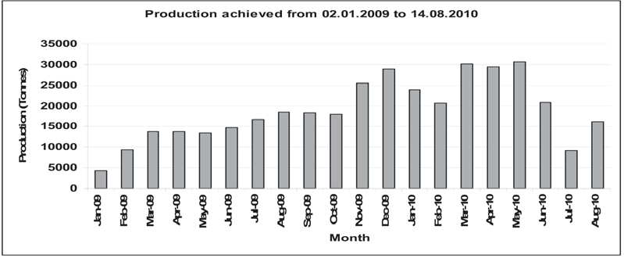

Slide 21
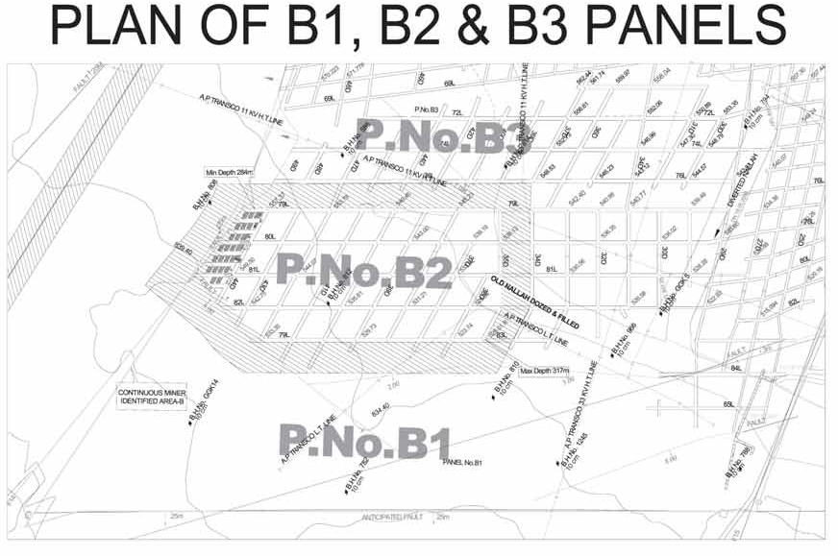

Slide 22
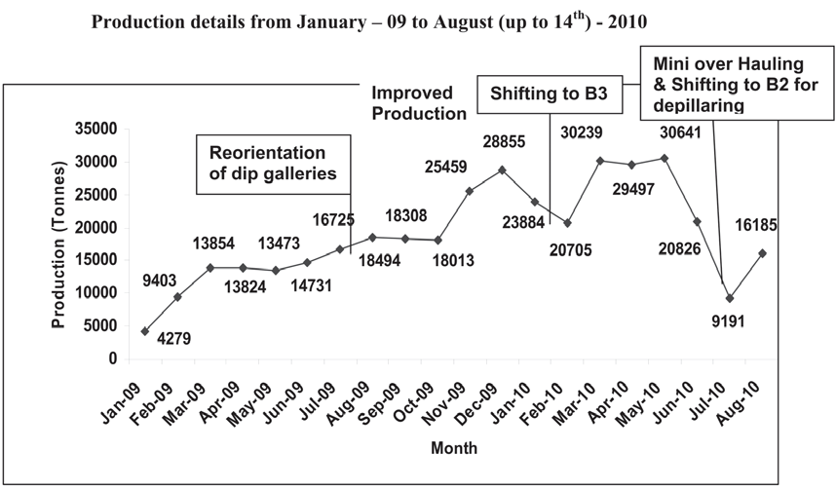

Slide 23
PROBLEMS & SOLUTIONS IMPLEMENTED WHICH RESULTED IN HIGHER PRODUCTION FROM B2 PANEL
PROBLEMS | SOLUTIONS
1. While working with Continuous Miner and Roof Bolter, appox. 30 GPM of water is consumed, which is damaging the floor causing slush and resulting in skidding and jamming of the machinery at junctions. | Ditches made at every junction and water is diverted into that ditches. Bucket pumps installed to pump out the water.
2. Soft coal floor getting broken away due to heavy weight of machinery CM : 72 T Roof Bolter : 30.513 T Ram Car : 25 T (without load) Ram Car : 40 T (with load) | Instead of air fill tyres foam filled tyres were introduced and also applied chains to the tyres.
3. Ram cars / Continuous Miner jamming in slush, sometimes causing more delay. | Installed the Feeder Breaker at the junction due to which the Ram cars can unload from three directions. This arrangement successfully prevented bogging down of the Ram cars at the junctions.

Slide 24
CONTINUE….
4. Problem at B1 panel. Two faults occurred at B1 panel, which deteriorated the roof condition. Blogging of ram car and CM at floor. | a. Cut out distance reduced from 3 to 4m.
5.Problems at B2 panel. a. The problems are almost the same as B1 Panel (roof & floor problems). | A . Most of the falls have occurred only in dip galleries. B . Due to the above, it was decided to re orient the dip galleries since the level galleries were found to be stable. C . After reorientation of dip galleries, the roof was stable and the cut out distance could be increased from 4m to about 12m. D . At present the strata problems are reduced.
6. Mis-Match of CM and Roof bolter.

Slide 25
PERFORMANCE OF CONTINUOUS MINER
The production in B1 panel from 02.01.2009 to 22.01.2009 is 4279 Tonnes only at an average of 183 Tonnes / day.
The production in the Continuous Miner district has increased from 9000 tonnes to 31000 tonnes / month with an average daily production 1100 tonnes.
The Continuous Miner was idle many times for want of supported roof.
Mis– match of Continuous Miner and Dual Boom roof bolter during development. (CM idle at least 6 hours in a day).

Slide 26
COST ANALYSIS
During the year 2010 – 2011, 81,341 tonnes of production was
achieved against the targeted 1, 04,000 tonnes.
Up to June 2010 Rs. 13.80 Crores Capital expenditure has
been incurred on Continuous Miner Technology.

Slide 27
The details of different cost components and profit earned are as follows:-
DESRCIPTION | AMOUNT IN RS.LAKH
WAGES | 373.85
STORES | 172.98
POWER | 45.14
OTHER EXPENSES | 537.82
DEPRICIATION | 163.97
OPERATIONAL COST | 1293.77

Slide 28
CONTINUED….
WORKSHOP | 18.46
AREA OVER HEADS | 67.02
TOTAL COST OF PRODUCTION | 1379.25
SALES REALIZATION | 1404.09
PROFIT/LOSS | 24.84

Slide 29
CONCLUSION
The experience gained in working the three panels – B1, B2 & B3, would be very useful in future, in successful extraction with CM technology.
After reorientation of dip galleries there is an increasing trend in production.

Slide 30
THANK YOU

